Slide 1
111-1 六年級 英文科 課程計畫
連偉蓉

Slide 2
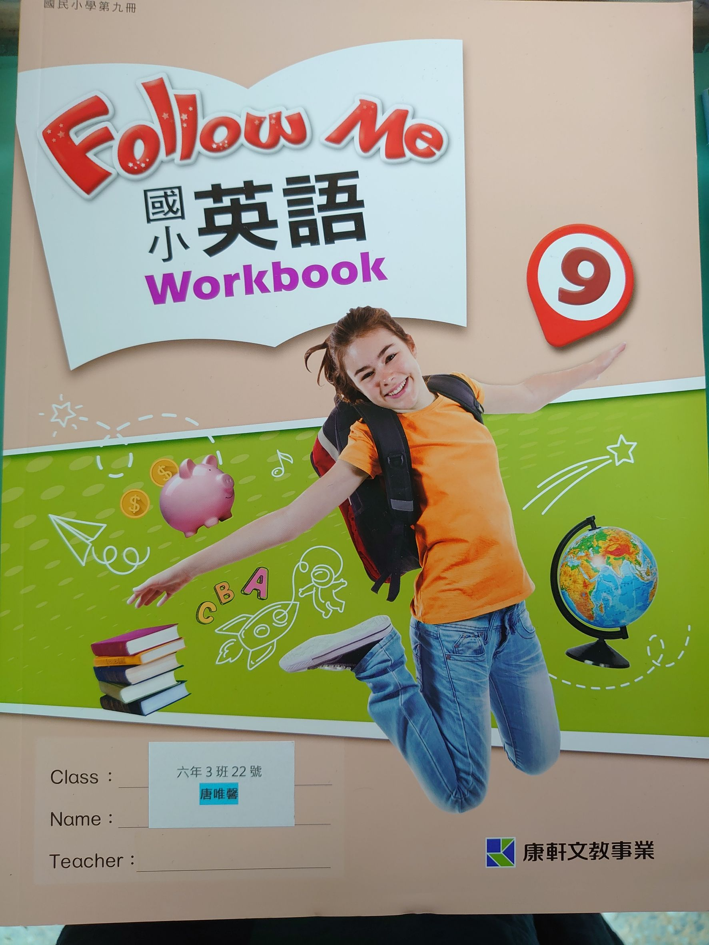
教 材
workbook
textbook
Exercise book

Slide 3
繪 本 教 學
Picture Books
Teacher Whitney

Slide 4
教 法
Communicative Approach
Task Base
01
02
任務導向
溝通式教學法

Slide 5
目標 : 增進英文聽說讀寫能力

Slide 6
評 量 方 式
多元: 聽力 口說 讀寫 學習態度
定期: 二次 紙筆評量

Slide 7
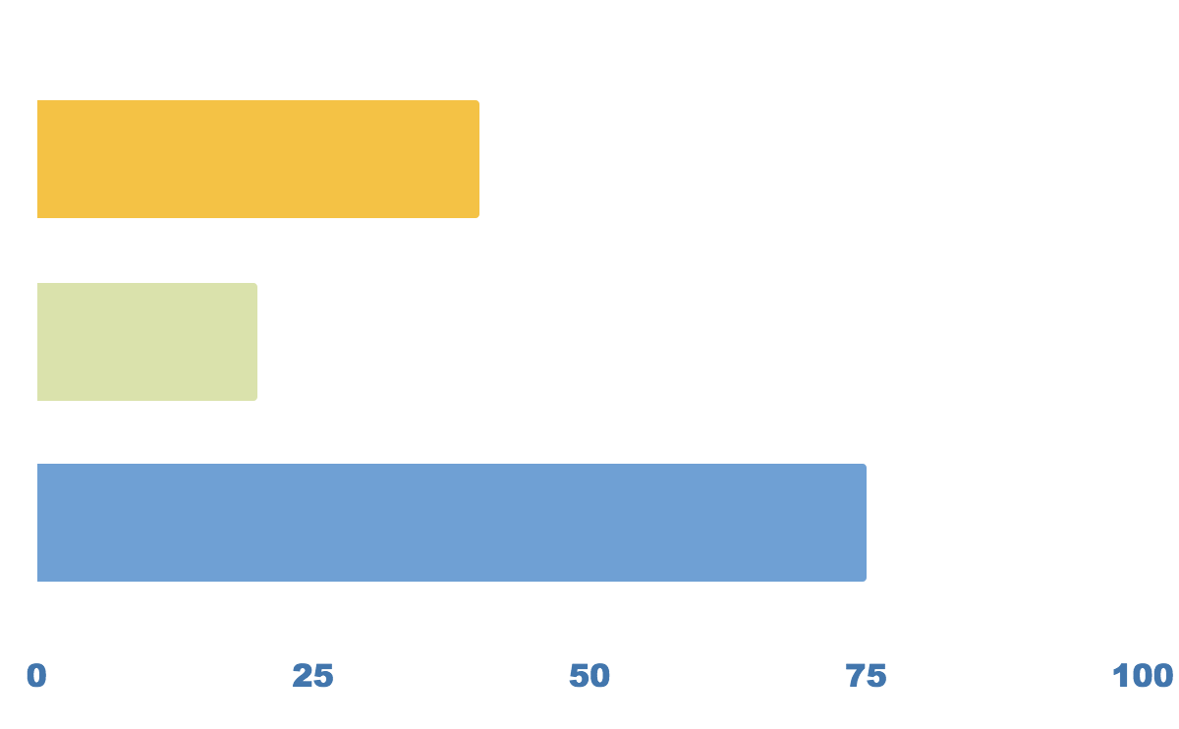
多元評量 vs 定期評量
Listening & Speaking
35%
Homework & Performance
25%
40%
Mid-term & Final

Slide 8
親 師 合 作
Heavy workload AND house chores
Care taker
At school
At home
照顧者
繁忙的工作和家務
1. 作業 確實完成
2. 小考 單字句型
1. 課本
2. 文具:螢光筆+鉛筆+橡皮擦

Slide 9
聽力+口說
書寫作業
單字+句型

Slide 10
小考單字句型表
Date | New words | Sentences
9/8 | August long hair short hair curly hair | What does she look like?
9/16 | September a braid a ponytail a crew cut | My brother has short black hair and brown eyes.
9/23 | straight hair people different looks braces | Does she have long curly hair?
9/30 | classmate blond laugh best friend | There’s something else.
10/7 | sports center department store police station convenience store | Where is the museum?
10/14 | October across from between next to | It’s next to the post office.
10/21 | bank restaurant movie theater excuse me got lost | Is the hospital across from the library?
10/28 | Let’s do something fun together. | This is not the way to the bookstore.

Slide 11
課 表
 | Mon. | Tue. | Wed. | Thu. | Fri.
1 |  |  | 602
2 |  |  | 603
3 |  |  | 601
4 |  |  |  | 603
5 |  |  |  | 601 | 602
6 |  |  |  |  | 601
7 |  |  |  | 602 | 603

Slide 12
重 要 記 事
期中評量
期末評量
聽力小考
口說小考
單字句型小考
作業
1
2
3
111/11/2
112/1/2
2次
4
5
6
2次
週五
聽說跟讀或書寫

Slide 13
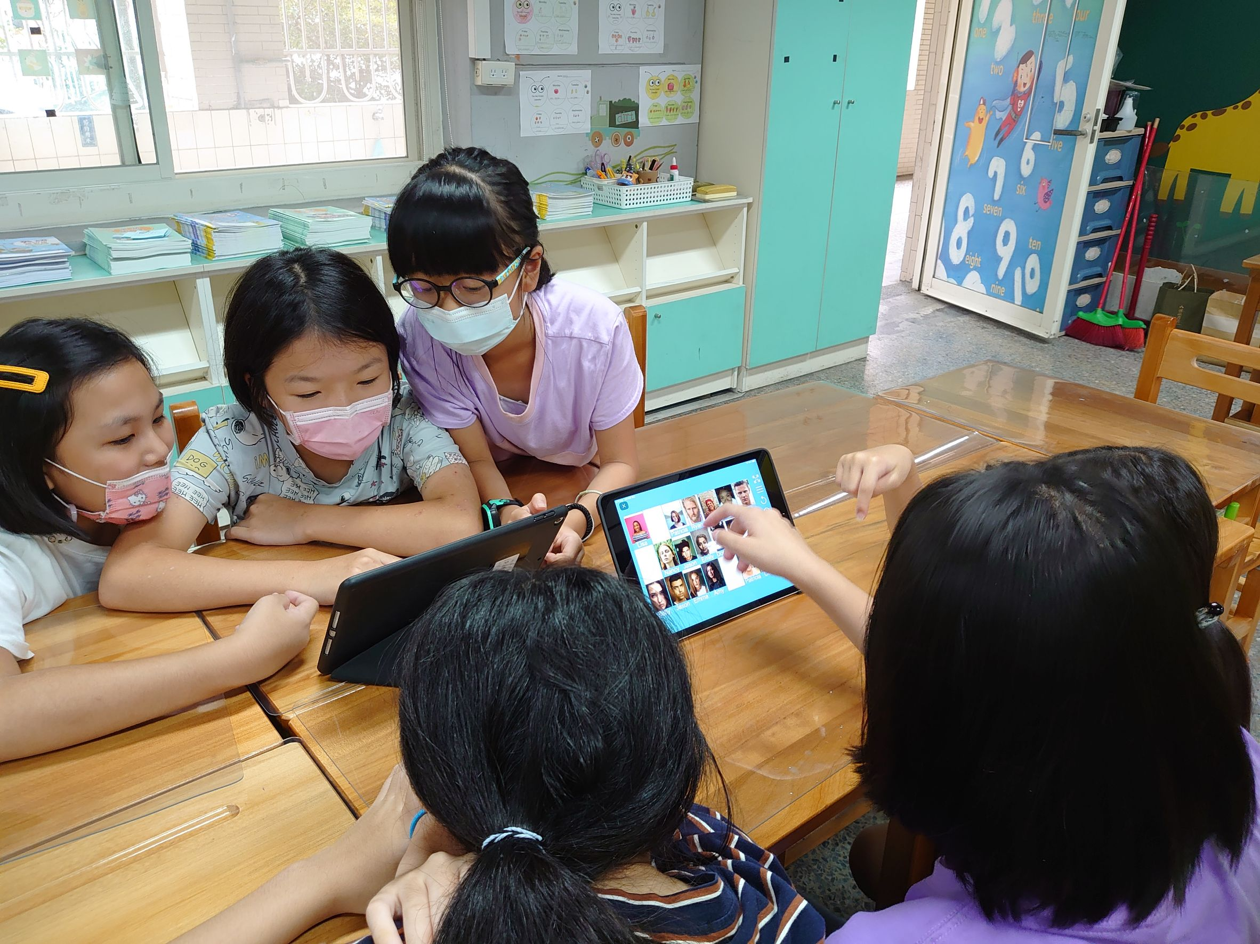
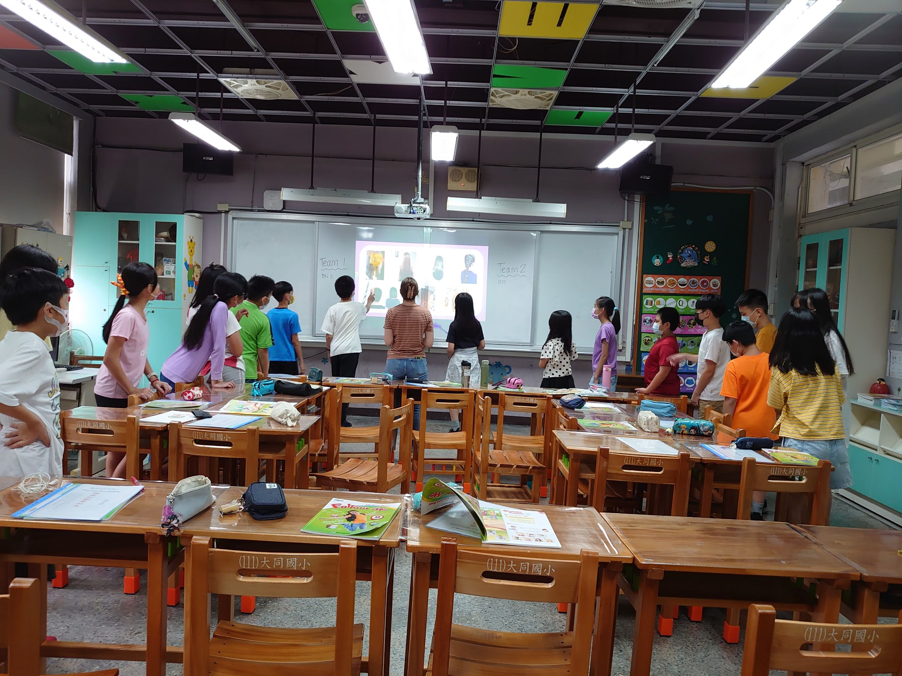
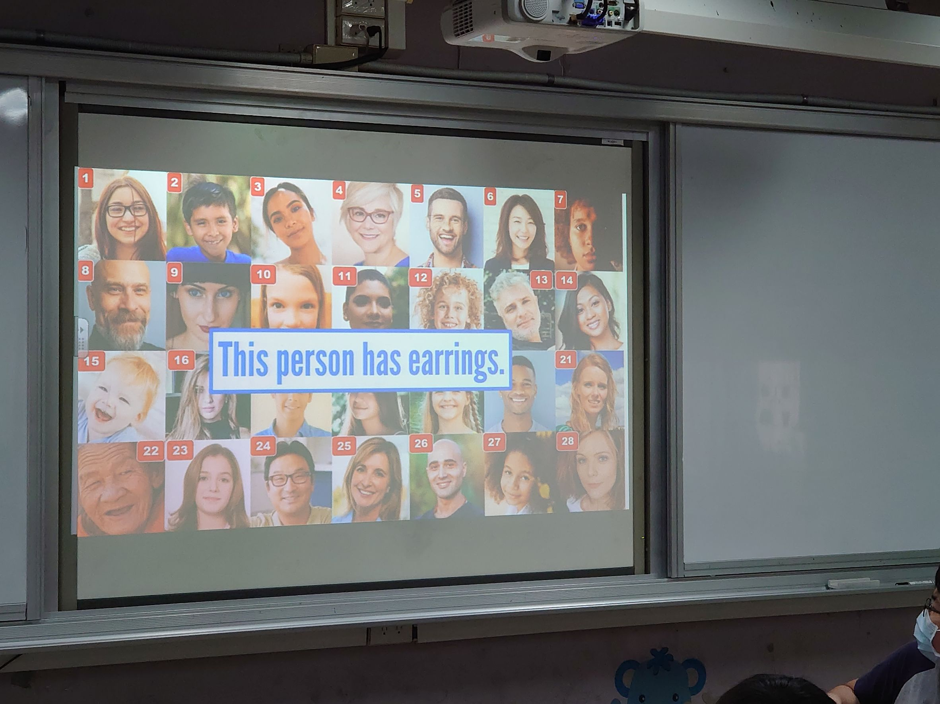
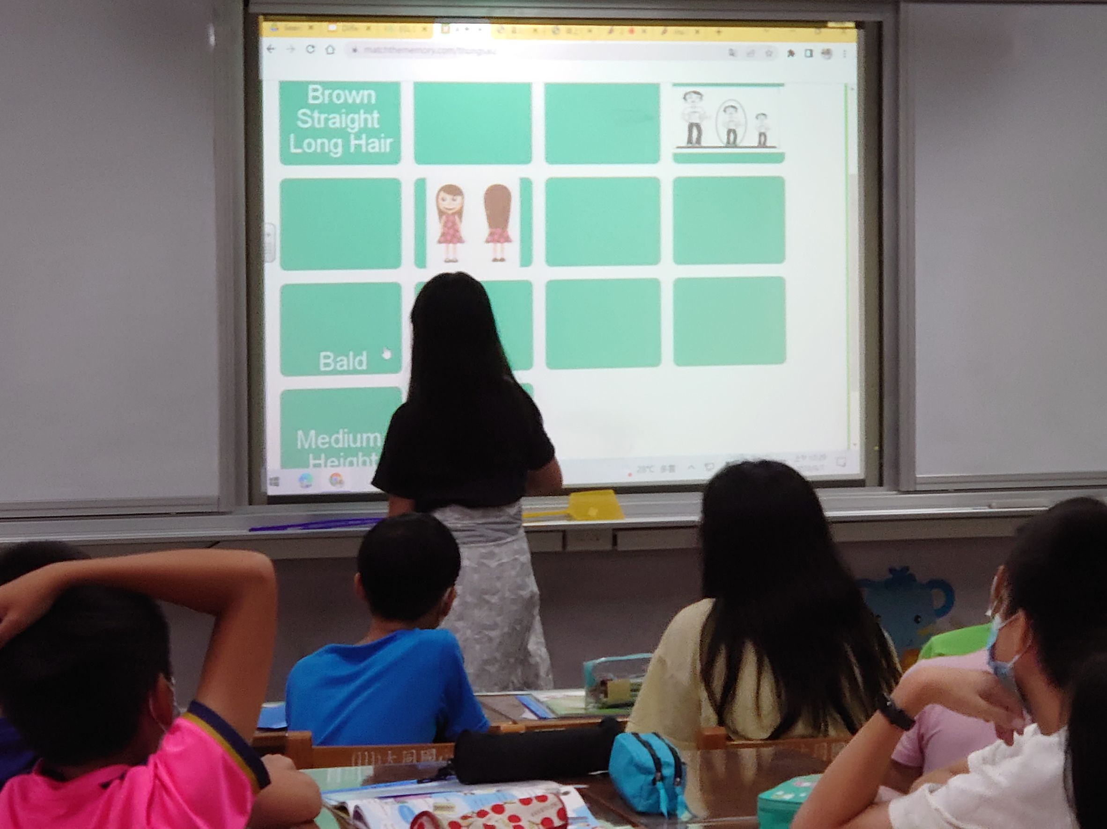
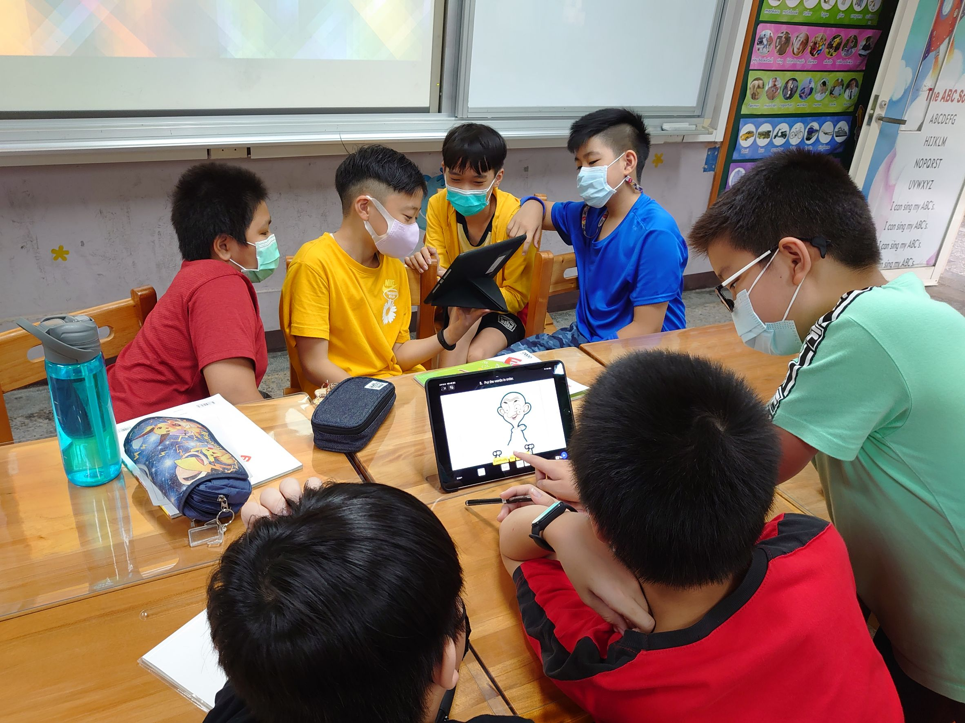
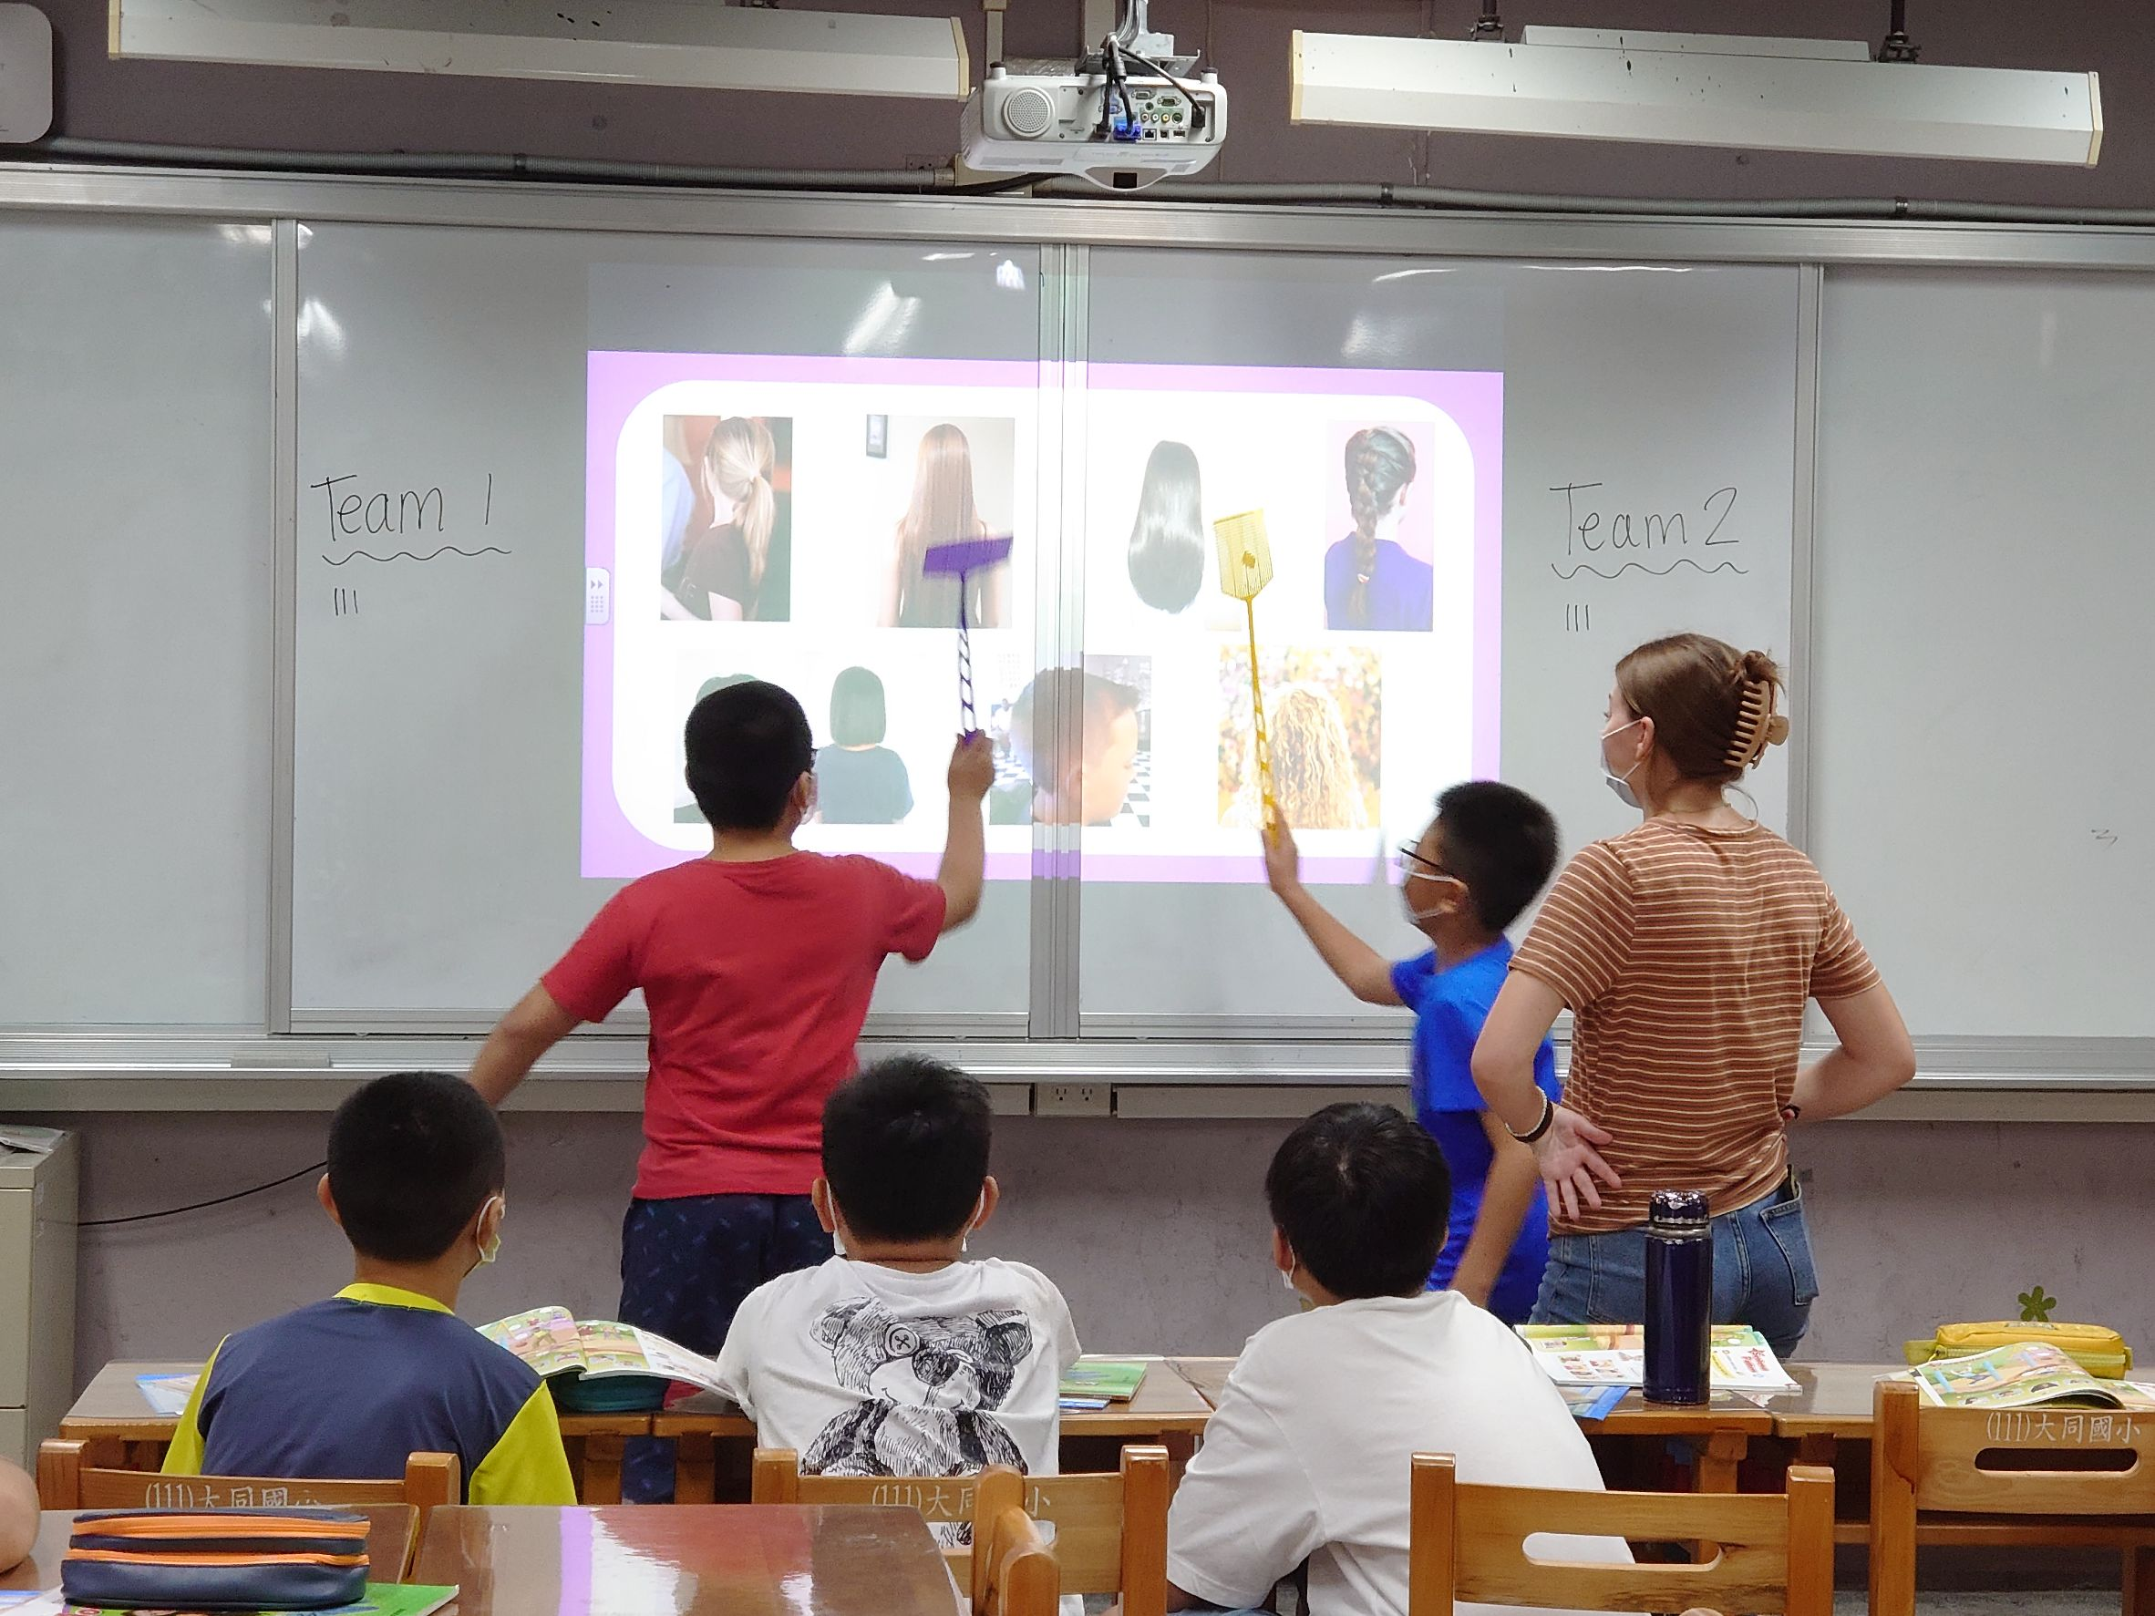
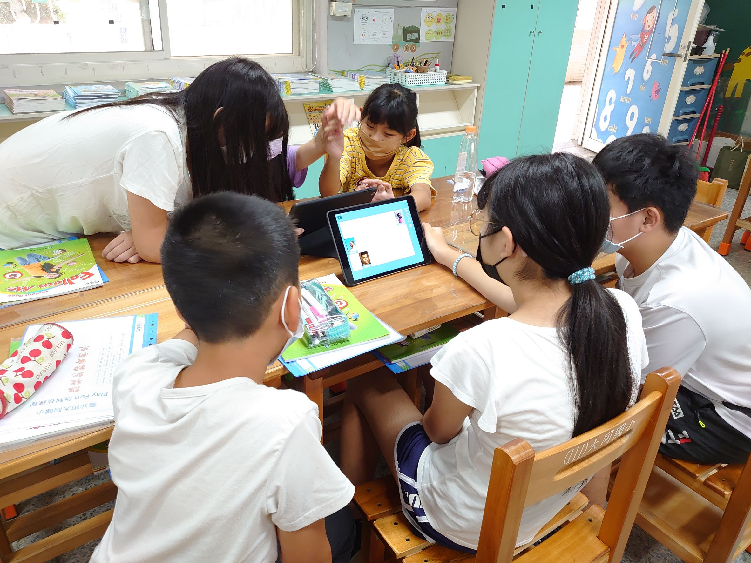
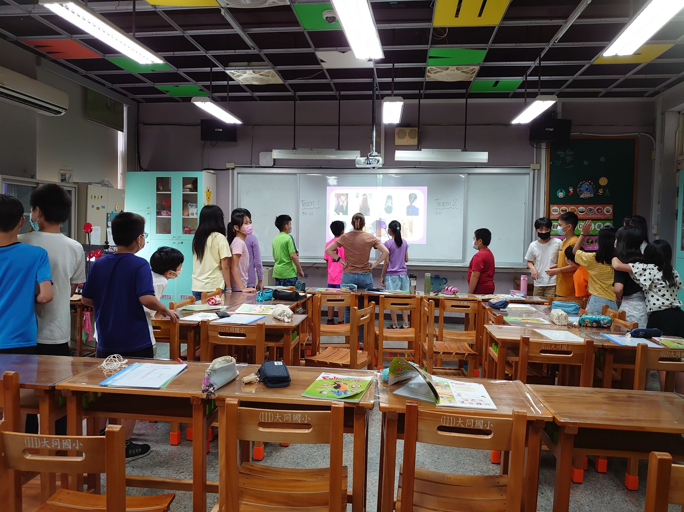
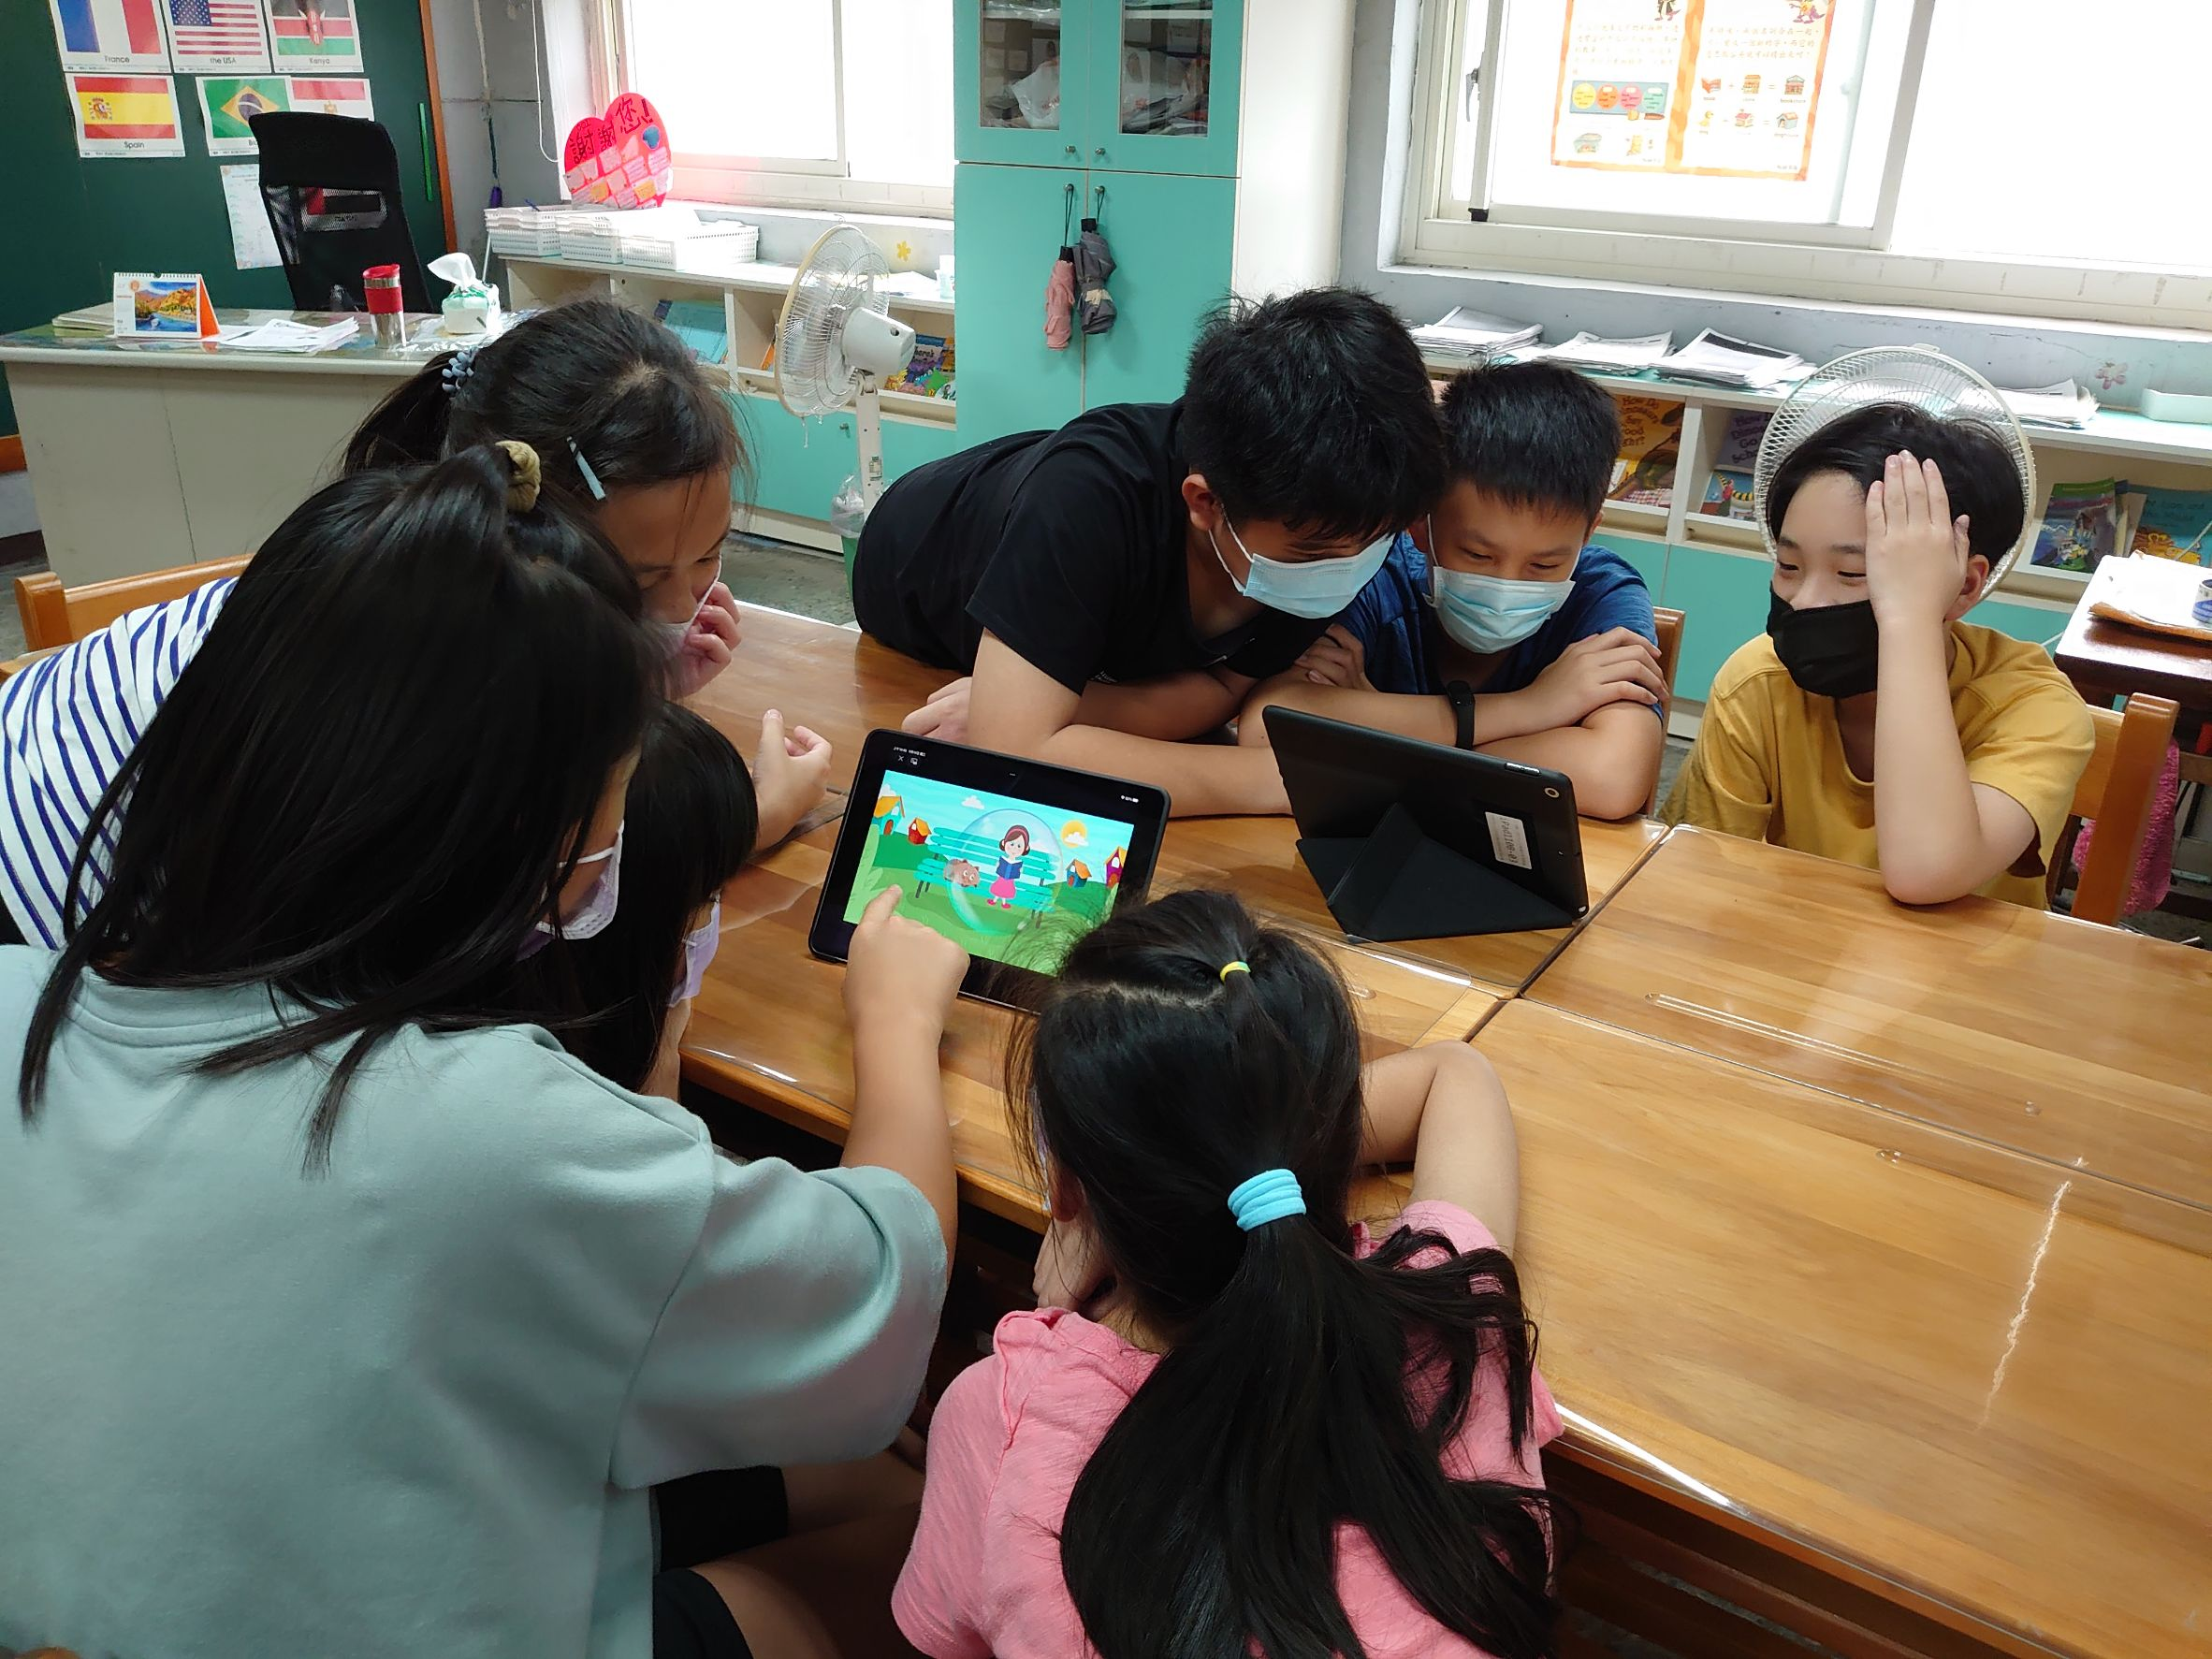
iPad

Slide 14
Step by step
基本語彙句型
加深加廣短文
精熟所學
Textbook
Picture books
Master
扎根
提供多樣化的媒體
展現自信

Slide 15
Thank You!

Slide 16
THANKS!
Do you have any questions?
youremail@freepik.com
+91 620 421 838
yourcompany.com
Please keep this slide for attribution

